Slide 2

THE IMPORTANCE OF AGAPE
reflections on God’s unconditional love by
Ida Wheeler and Judy Luster
Notes:
Welcome to “The Importance of Agape” where Kairos Inside, Kairos Outside and Kairos Torch are all in to “listen, listen, love, love”. We are here exemplifying that we are all in …to nurture the spirit of agape, we are all in support of sharing agape with other programs and communities, we are all in to getting agape within reach of our hands’ creativity - within reach of our community – within reach of the United States Postal Service and within reach of the world-wide web. Agape - all in its various forms, in all of the programs - invites all in for the relationship with Christ and God's amazing love.
We are so glad that you are all in this room and we are blessed to be your presenters today…Ida Wheeler and Judy Luster.

Slide 3
Notes:
Let us bow our heads, close our eyes and hear words from the greatest love letter ever written:
All In, In All Things from 2 Corinthians 9:8 … God is able to bless you (us) abundantly, so that in all things at all times, having all that you (we) need,
you (we) will abound in every good work.
All In for Love from 1 Corinthians 13:4-7 (NIV)
Love is patient, love is kind. It does not envy, it does not boast, it is not proud. It does not dishonor others, it is not self-seeking, it is not easily angered, it keeps no record of wrongs. Love does not delight in evil but rejoices with the truth. It always protects, always trusts, always hopes, always perseveres.
…because God is love.
John 4:8 (NIV)
Acts 10:33 So I sent for you immediately, and it was good of you to come. Now we are all here in the presence of God to listen to everything the Lord has commanded you to tell us.
Colossians 3:14 And over all these virtues put on love, which binds them all together in perfect unity.
Lord God, we thank you that you have given us unconditional love…all in our lives we have seen your love…let us fall all in love with you and guide us to bind all we meet together… all in love. Amen.

Slide 4
WHAT IS AGAPE IN KAIROS?
reflections from Kairos Program Manuals
Notes:
Consider for a moment what agape is in Kairos…

Slide 5
Meaning “All In” Kairos Program Manuals
Agape, as used in Kairos, is the offering of unconditional love to another person with no expectation of receiving anything in return. It is wanting the very best for another person and being willing to be used by God to move them toward that “best” without regard to personal sacrifice.
Kairos Inside Kairos Outside Kairos Torch
page 92 page 110 page 62
Notes:
This is the repeated phrase – all in the Kairos Program Manuals… “Agape, as used in Kairos, is the offering of unconditional love to another person with no expectation of receiving anything in return. It is wanting the very best for another person and being willing to be used by God to move them toward that “best” without regard to personal sacrifice.”
(Following are the excerpts from each manual….but this is only for further clarification.)
Kairos Inside (p. 92)
“Agape” is a word in the Greek language of the New Testament used to describe God’s unconditional love toward us, as distinguished from the other words in the Greek language to describe human expressions of love, such as storgê (natural affection), philia (friendship), etc.
Agape, as used in Kairos, is the offering of unconditional love to another person with no expectation of receiving anything in return. It is wanting the very best for another person and being willing to be used by God to move them toward that “best” without regard to personal sacrifice.
Kairos Outside
Agape is an offering of unconditional love to another person without expecting anything in return. Agape is: desiring the very best for another person and being willing to try to meet that need without regard to personal cost. The giving of agape is a sacrifice; that is an act made holy by offering it to God. All agape must be done in prayerful love. (p. 110) Agape is Christ’s love delivered through the Body of Christ. (p. 7) Agape is any prayer or act of love offered to God for the benefit of someone else. It is not necessary, nor is it even important that you know who has performed agape for you. It is only important that you know it was done for you. You may often hear of the acts of agape as “sacrifices” because a sacrifice is any act made holy by offering it to God. (p. 174)
Kairos Torch
Agape is a Greek word in the New Testament used to describe God’s unconditional love toward mankind. In Kairos, agape is the offering of unconditional love to another person with no expectation of receiving anything in return. It is wanting the very best for another person and being willing to be used by God to move that person toward that best without regard to personal sacrifice. (p. 62)

Slide 6
THE PURPOSE OF AGAPE
reflections from Kairos Program Manuals
Notes:
Consider for a moment, if you will, what the purpose of agape is in Kairos….

Slide 7
Purpose “All In” Kairos Program Manuals
Kairos offers a wonderful opportunity to help Christians respond to Christ’s calling by communicating His love through their sacrificial gifts of agape. That should be our focus, and the Weekend will be filled with all the love of the Body of Christ that you could ever desire!
Kairos Inside Kairos Outside Kairos Torch
page 92 page 110 pages 62 and 43
Notes:
… one of the great gifts of Kairos is that people can indeed answer Christ’s call to love one another and send expressions of love that restores!
Kairos Inside
It is so important that we move beyond the desire to accumulate “stuff” for the Kairos Weekend and begin to focus on the desire of Christ that people visit the prisoner. For the vast majority of Christians that “call” is simply beyond them. However, one of the great gifts of Kairos is that through Kairos, people can indeed visit on behalf of Christ, even if they never set foot in a prison! In other words, Kairos offers a wonderful opportunity to help Christians respond to Christ’s calling by communicating His love through their sacrificial gifts of agape. That should be our focus, and the Weekend will be filled with all the love of the Body of Christ that you could ever desire! (p. 93)
Kairos Outside
Kairos Outside uses the term “agape” to refer to personal and group prayer on behalf of others, so they might become more open to God’s love. (p. 110)
Kairos Torch
A far reaching purpose of the agape team is to invite people to visit incarcerated on Christ’s behalf, even if they never set foot in a prison by communicating His love through their sacrificial gifts of Agape.(p. 62)
Drawing on the Theory of Planned Behavior and The Theory of Reasoned Action, agape strengthens positive beliefs, weakens negative beliefs, and introduces new beliefs by allowing investigation of current attitudinal, normative and efficacy beliefs of the individual before choosing the beliefs on which to intervene. (p. 43) Agape offered during the Kairos Torch Weekend draws the youth to shifting their beliefs to a pro-culture perspective.
Celebrating each youth at the doors as their name is call when entering
Placing the Participant’s name or picture in the Creation video
Participant reintroduction as “Special Creation”
Answer discussion questions from each talk
Poster reinforcement activity
Introduction of agape prayer chain
Presentation of Forgiveness & activity
Designing God Box
Reinforcement activity for “Walled Off” – building of wall
Guide Meetings
Forgiveness Service
Weekend Summary Skit
Receiving Personal Agape
Closing Ceremony
As retold by Kevin Resnover:
One Kairos Torch Participant shared a story from the podium at his Closing Ceremony. Looking at those in the audience, he saw that only one adult was black and everyone else was white. He said, “You all have messed me up. All my life, I heard the talk on my front porch about how no white person ever cared about us black people. And I come to this Kairos thing, and all you all just love me and feed me and be nice to me. You have messed me up ‘cause now I know you care. What do I do with that?”

Slide 8
THE EXPRESSION OF AGAPE
flows through the Body of Christ
Notes:
When Christians grasp the totality of agape and their inclusion in the Body of Christ, Weekends will be filled with overflowing love from the Body of Christ. The entire Kairos Weekend and Continuing Ministry becomes an expression of God’s unconditional love being offered through the Kairos volunteers’ presence, conversations, gifts of time, presentation of poster agape, prayer, blessings of snacks and meals, music and laughter.

Slide 9
Expressions of Agape
            Invisible or visible
            General agape is tangible
            Personal agape is unique and tangible
Every person and every part of every
Kairos Weekend and Continuing Ministry becomes an expression of God’s unconditional love – agape!
Notes:
Invisible or visible agape is:
Time…Michael, a Kairos Torch Participants once said, “Love is time.”
Relationships…the smiles, the laughter, the positive words, conversation and discussion
Table Families or Tables…invitation to be involved and to express ideas
Unconditional acceptance… that we are gathering together for a Christian journey
Hospitality… meals and snacks served with a smile to all in the community room
Intercessory prayer given personally or corporately
Tangible agape is anything addressed or given to all Kairos Participants or Guests.
General agape is considered Green Agape (Money), Wall Agape…personalized to the specific Kairos Weekend, Notes/pictures drawn by children, Prayer Chain-created “new” each time to continue involvement of those near and far, Prayer Vigil-created “new” each time to continue involvement of those near and far and shows the uninterrupted covering of prayer for the Kairos Weekend at a glance. These people who are only connected to us because of the love of our Lord. Cakes – for Kairos Torch and Kairos Outside, Cookies, even though more facilities are restricting this sweet agape, Placemats, Flowers, Walking in Love and Closings
Personal agape includes the “Special Letters” from the Residents or Participants for Kairos Outside Guests, “warm fuzzies” placed on the Guests beds or pillows, personal letters written to the Residents or Participants by the Kairos Inside team and Kairos Torch team respectively, God’s Word, Your Journey to Freedom Bible and the accompanying Discussion Guide for Kairos Torch and Kairos Inside (as allowed) and in the case of Kairos Torch a birthday cake with the Participant’s name on it.
Agape is expressed in every person, in every moment and in every act leading to the Kairos Weekend, throughout the Kairos Weekend and following the Kairos Weekend.

Slide 10
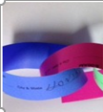





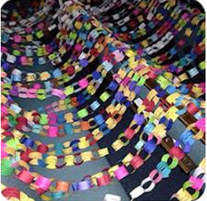


Glimpses of Agape

Slide 11





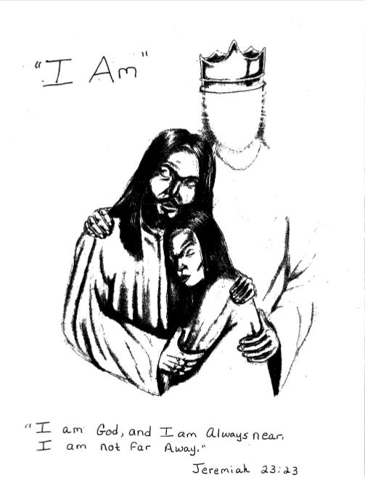

Glimpses of Agape

Slide 12
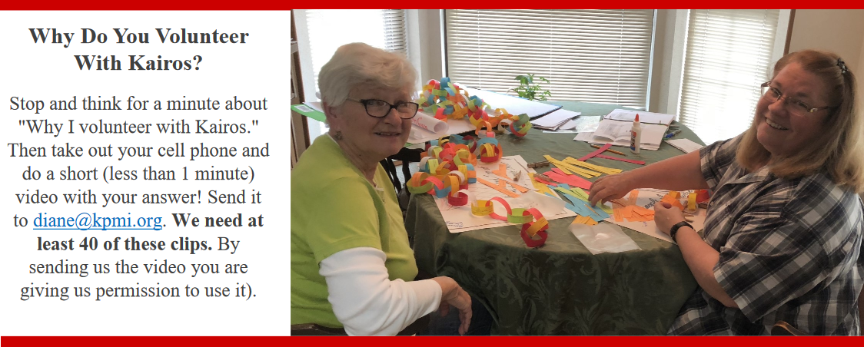

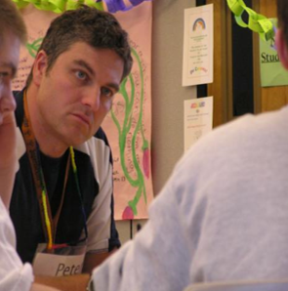

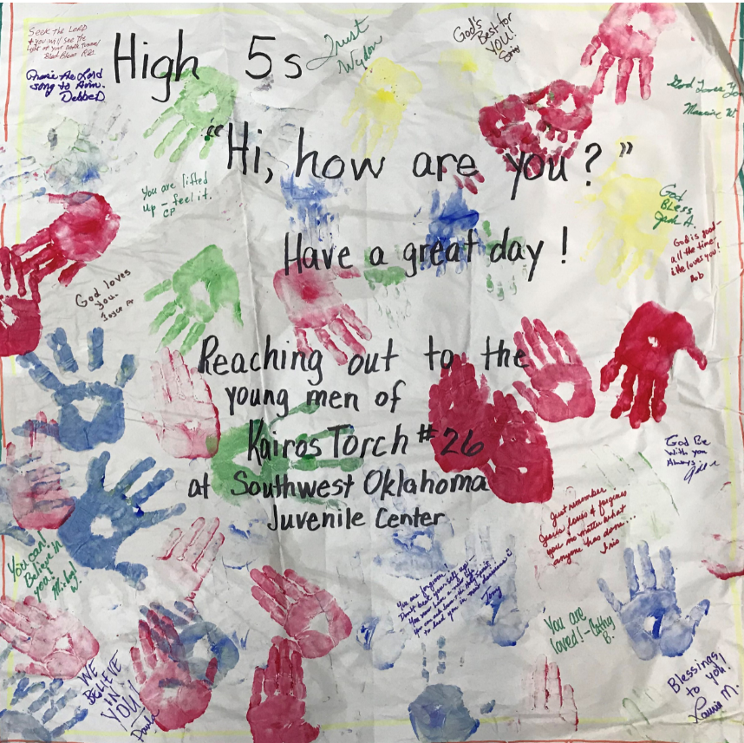

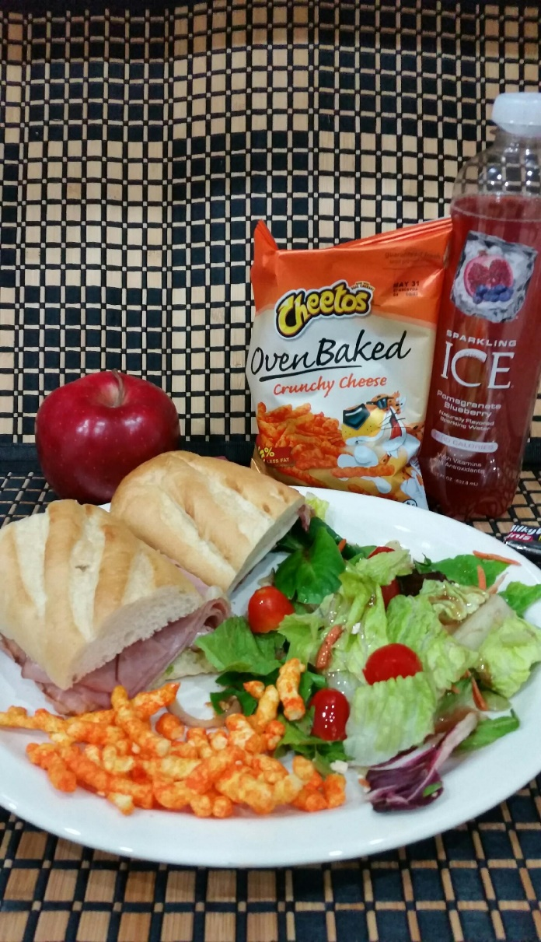

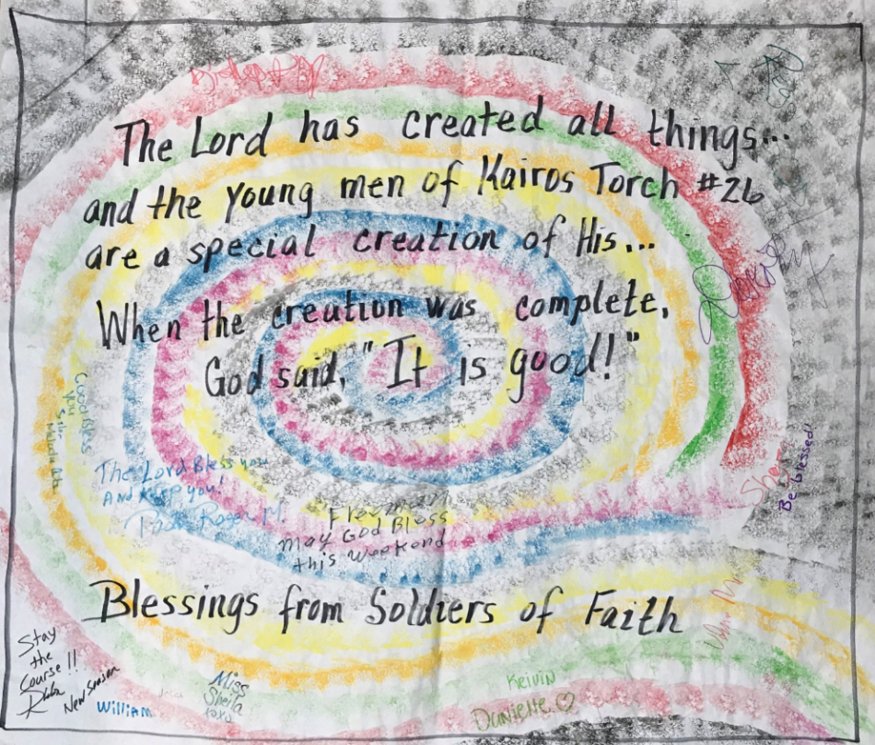


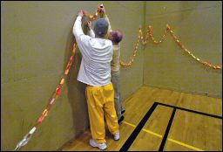



Glimpses of Agape

Slide 13

THE IMPORTANCE OF AGAPE
Effectively Managing All Aspects of Agape

Slide 14
Those Needed to Manage Agape
            Advisory Council Secretary
            Advisory Council Agape Coordinator
            Weekend Agape Coordinator/Leader
            Working Better Together to Shower Agape
            Delegate Agape Opportunities
Notes:
Advisory Council Secretary, a standard position for all Kairos program: (p. 13-14)
Is responsible for notifying Kairos of approved Weekends for posting using the "Register Weekend Info" link on the www.MyKairos.org website. This is the critical first step once the Kairos Weekend dates have been determined.
Advisory Council Agape Coordinator, a standard position for all Kairos programs is responsible for these tasks. For the ongoing flow of Agape from and to each Kairos program, the relationship with other programs must be maintained and never neglected…each of us must give to receive. So, please give. (p. 16-17)
Keeps informed of upcoming Kairos and other 4th Day Weekends in order that written expressions of agape can be prepared for those Weekends. Agape should be prepared for other programs in the State, nationally and internationally. An intentional effort should be made to provide agape for #1 Weekends. Creates prayer vigil/chain signup sheets for other Kairos Weekends and 4th Day communities. Solicits prayer commitments from Kairos community (including Kairos Inside graduates) and forwards finished agape to appropriate Agape Coordinators (per direction of State Agape Coordinator) advises Weekend Agape Coordinator on acceptable forms of agape, pursuant to Kairos manuals and institutional regulations and assists Weekend Agape Coordinator in registering prayer vigil/chain on www.3dayol.org and other appropriate Internet sites including the Kairos website (http.MyKairos.org). Utilizes social media for prayer sign up as appropriate. It is required to be on the Kairos website. Facilitates transportation of material for creation of written forms of agape, (i.e., prayer commitments, posters, place mats, etc.), and supplies to and from the institution. Periodically mails/delivers (through the Institutional Liaison or Weekend Leader) a replenishment supply of Kairos Outside brochures and Guest Reservation forms to prison chaplains and teams.
The Weekend Agape Coordinator/Leader responsibilities are identified in the Kairos Program Manuals (Kairos Inside pages 92-95, Kairos Outside pages 110-113 and Kairos Torch pages 62-71) and can be found in Ezra for each program.
The sum of the parts equals “working better together” to shower agape on Kairos Weekends.
No one can carry the responsibility of agape alone
Everyone responsible for links in the gift of agape can learn more about their opportunity
Embrace the heart of pouring unconditional love into the “givers and the getters”
Delegate the opportunities
Ask others to create placemats and decorate cookie bags
Generate financial support for the Kairos Weekend with meal tickets and green agape donations
Distribute prayer chain links for people to sign
Distribute sections of the prayer vigil to ensure continuous prayer, but encourage the use of the prayer chain links if none of the times on the vigil are possible for the prayer warrior.
Prepare an Agape Book to float around churches and 4th Day communities to assist in offering support of the Kairos Weekend.

Slide 15
THE IMPORTANCE OF AGAPE
Involving the Community in Agape
Involving the Local Church
Involving the World

Slide 16
Involving the Community in Agape
            Simply share why we do what we do
            Encourage small steps to keep agape flowing
            Create “Adopt Agape”
            Take “Adopt Agape” to others with completion and return directions
Notes:
Training why we do what we do with an undergirding of scripture and Weekend reflections by Guests and Participants helps us involve the Kairos community in Agape. This is the first step in encouraging small steps to keep the agape love flowing. Invite the community to come to the Agape Parties to keep the momentum going during the team building process. Creating “Adopt Agape” places wall agape in the hands of others so they don’t struggle to draw, paint or make the visual message of hope and encouragement for the Kairos Participants, Residents and Guests we serve. Let it come back to the Kairos Weekend with personal messages and first name last initial signage.

Slide 17
Involving the Local Church
            Send Kairos volunteers to their churches with prayer chains, prayer vigil, meal tickets for donations, invitations to Closing and “Adopt Agape”
            Ask for a time to share your Kairos story
            Maintain the Kairos connection with churches
Notes:
We invite the churches to participate in God’s agape love.
Send a Kairos volunteers to their churches with an agape table with “Adopt Agape”, prayer vigil sheets, prayer chain links, meal ticket fundraiser (hospitality love), and invitations to the closings (along with the requirements to attend)
Ask churches for a time to speak to the small groups, Sunday School Classes, or have a Kairos Information Table in the church’s fellowship area to share the stories
Continue the Kairos relationship through personal conversation or newsletter to follow up on the effect of God’s love in the lives of all associated in Kairos programs.
Love never dies.

Slide 18
Involving the World
            Register your Kairos Weekend on mykairos.org
            Use the Kairos Kalendar to personalize agape
            Email agape to the Weekend Agape Coordinator/Leader or to “Where We Serve” at mykairos.org
            Register for prayer on http://www.3dayol.org
Notes:
A far reaching purpose of the Agape Team is to invite people to visit incarcerated youth on Christ’s behalf, even if they never set foot in a prison by communicating His love through their sacrificial gifts of Agape love.
Register your Kairos Weekend on mykairos.org
Use the information posted on the Kairos Kalendar at mykairos.org to send personalized agape directly to the Agape Leader/Coordinator at the designated email address. This approach insures fresh, new and unique agape for each Kairos Weekend.
Submit electronic agape by following the pathway at the bottom of the opened “Where We Serve” tab – Click here to e-mail your agape and have it posted on the website for download. Be aware that electronic agape is not taken down from the “Where We Serve” site, unless you ask that it is removed. Send your request for removal to bill@kpmi.org. Include the website address above the specific piece of agape. Please monitor what is in the inbox for specifically addressed agape… let our “love” not grow old and dated.
Electronic agape from around the world. Send wall agape to get wall agape. Send names for prayer vigils to get names for prayer vigils. Send prayer chain links to get prayer chain links. Send written prayers of encouragement and hope to get written prayers of encouragement and hope.
When Christians grasp the totality of agape, Weekends will be filled with overflowing love from the Body of Christ. Agape from the unseen body offering their love through prayer, art, financial support, sharing the story of God’s special time…His Story that changes people, the evidence of love given from people we don’t even know to people they don’t even know… evidence of love given without having to earn or perform to be loved… the introduction to the purest and best love of all… meeting God, who is love.

Slide 19
ALL IN – ART
THE “MESS” TO BLESS
Notes:
Giving and getting agape is important – so let’s get our hands on the how to!

Slide 20

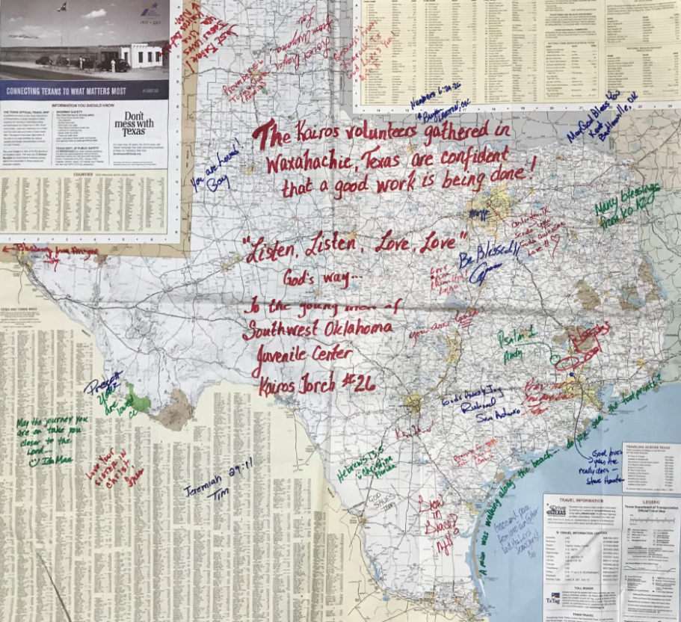
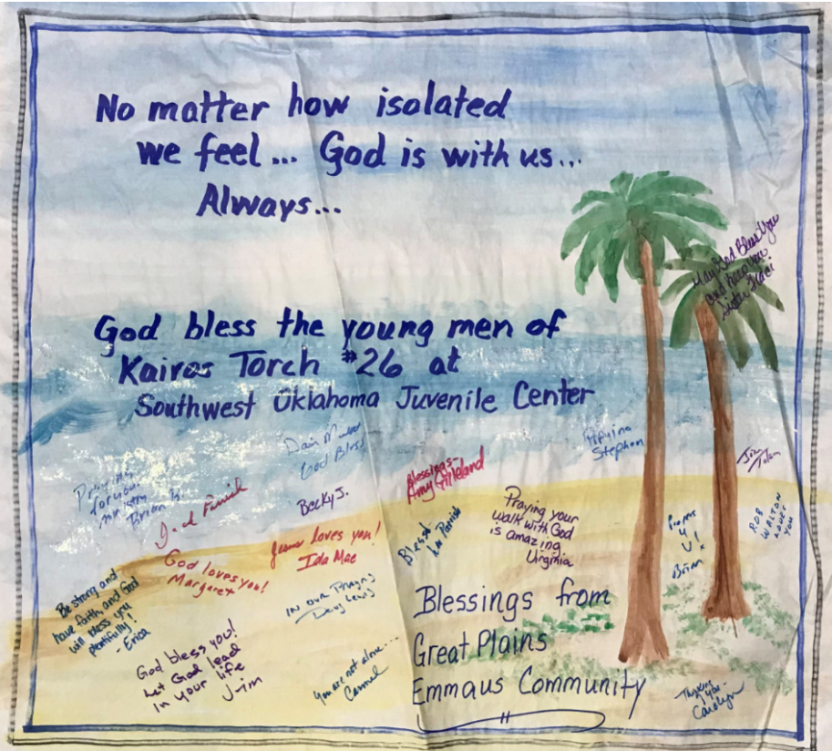
Notes:
These are just some samples of hand carried or snail mail wall agape
Make a picture on large flipchart paper. Add a simple, broad marker line around the picture to give the poster greater boldness when it is placed on the wall.
Select the Kairos Weekends from the Kairos Kalendar that you are sending agape to and take note of the facility’s full name, the gender of the population served (needed if you write something like “Greetings to the young men of Kairos Torch #27 at Southwest Oklahoma Juvenile Center”), the Kairos Weekend number, and the email address for agape.
Insert a personalized message or “greeting” to the specific institution and Kairos Weekend number, including a word of encouragement, word of wisdom, message of God’s love or prayer.
Share where the agape is coming from on the picture as a part of the “from”- facility, state and country. This information is helpful in showcasing the agape from around the world.
Tape a note on the back of the agape about when and where the agape needs to be sent in time to be displayed for the Kairos Guests and Participants. This note can be removed when the agape is back to the Weekend Agape Leader.
Have the Kairos community (or other Christian community) write personal notes on the picture to the Guests or Participants and sign with their first name and last initial.
Send the agape to its designated Kairos Weekend, either hand carried or snail mail!
Let’s take just a few minutes to get our hands on some wall agape…and get a few messages of hope written in for the #1 Weekends coming up this year. Because there is never enough time to do all of the steps, some have been started. You will see that the agape is directed to a Kairos program and where it was sent from is also included. (The organization the agape comes from is the most difficult to get…so train you “Adopt Agape” ambassador to add that information on the poster.) Please…stop at the Recruiting Booth in the common area to sign more agape…. Prayer chains and Prayer Vigils…
On Saturday, July 27th, whatever pieces of wall agape have been completed here at the conference will be sent home with a representative from that state to hand carry to the designated Advisory Council. If this agape was going to be mailed it can be stuffed into a legal envelope and snail mailed to the Weekend Agape Coordinator/Leader using the information available on the Kairos Kalendar “Agape Contacts for Upcoming Weekends.” Plan ahead for delivery!
Adopt Agape prepared during Agape Parties keeps the spirit of agape alive year round.

Slide 21
ALL IN – STEP BY STEP
ELECTRONIC AGAPE
Notes:
Electronic agape to Weekend Agape Leaders ….
Make a picture and/or take a picture (to avoid using someone else’s copyrighted photos) Look for free photos….
Format it on an 8 ½ x 11 ½ sheet of white paper
Select the Kairos Weekends from the Kairos Kalendar that you are sending agape to and take note of the facility’s full name, the gender of the population served, the Kairos Weekend Number, and the email address for agape.
Insert a personalized message or “greeting” to the specific institution and Kairos Weekend number, including a word of encouragement, word of wisdom, message of God’s love or prayer. Remember there is no distance in space and time when it comes to prayer and praise, so people are faithful to the message of encouragement if the prayer/praise is released right now for God’s special time during the Kairos Weekend.
Share where the agape is coming from on the picture as a part of the “from”- facility, state and country.
Have the Kairos community (or other Christian community) write personal notes on the picture to the Guests or Participants and sign with their first name and last initial.
Scan the agape and prepare an email to which it will be attached. In the email, please offer encouragement to the team and ask for agape and prayer vigil/prayer chain from their Kairos community. Give the date you need the agape returned, the return email address and physical address, your facility’s complete name, gender and population served along with the Kairos program and Weekend number.
Send the email with agape attached!

Slide 22

Would you rather have this agape …
Numbers 6:24-26
Bryan
Just as Matthew 4:16 says in the NIV,
“… a light has dawned.”
You have seen it. The light is Jesus.
Walk toward Him with all you have.
God is good!
Ben
God loves you!
George R.
John 3:16
Mary
Praying for you,
Roberta
Tom
Jesus died for you, live for Him!
Susan K.
Seek only Him!
Robert M.

Slide 23
or this agape?
What’s the big difference?
Numbers 6:24-26
Bryan
Just as Matthew 4:16 says in the NIV,
“… a light has dawned.”
You have seen it. The light is Jesus.
Walk toward Him with all you have.
God is good!
Ben
God loves you!
George R.
The 2019 Kairos Annual Conference attendees welcome the new Candidates of Kairos Inside #99 at Keyser Correctional Facility to the International Kairos Community.
Praying for you,
Roberta
John 3:16
Mary
Tom
Jesus died for you, live for Him!
Susan K.
I made this just for you.
Love,
God
Seek only Him!
Robert M.

Slide 24
How to create electronic agape
using Microsoft Power Point or a similar presentation program.

Slide 25
Set the Page Setup as an “On Screen Show (4:3)”. The blue line to the left is about the size that your slide will be. Insert a rectangle that is a little smaller than the a area. It will be nearly a standard sheet of paper,
US Letter or A4.

Slide 26
This presentation is formatted as widescreen to accommodate this instruction panel.

Slide 27





Select a picture, not too dark of a color scheme, and insert it inside the rectangle.

Slide 28
Crop the picture as necessary to either give you ample white space or in the case of a very light-colored picture, to fill the rectangle, only. When you have completed the agape, anything outside of the rectangle is not likely to print.

Slide 29
Create a greeting or prayer.
Greetings to the women of
Texas Hobby Unit Kairos Inside #35!
May the men of Kairos Inside #5 at Buena Vista Correctional Center in Colorado feel the hope of new horizons and a bright future.
Hoping each of you find balance and peace in the river of life…
Greetings to our new sisters of
North Queensland Australia Kairos Outside #7!
Greetings to new Torch Bearers of
Drakenstein,Western Cape, South Africa Kairos Torch #20!

Slide 30
A generic greeting prayer is easier to work with than to identify a specific location.
Greetings to the women of
Texas Hobby Unit Kairos Inside #35!
May the men of Kairos Inside #5 at Buena Vista Correctional Center in Colorado feel the hope of new horizons and a bright future.
Hoping each of you find balance and peace in the river of life…
Greetings to our new sisters of
North Queensland Australia Kairos Outside #7!
Greetings to new Kairos Torch Participants of
Drakenstein, Western Cape, South Africa Kairos Torch #20!

Slide 31
Insert the greeting or prayer in your rectangle near the picture.
Hoping each of you find balance and peace in the river of life…

Slide 32
Insert a text box and include instructions not to sign or write inside of it or outside of the larger rectangle. Export the slide to a .jpg and print it. Then distribute it for signatures and messages of hope.
Hoping each of you find balance and peace in the river of life…
Please do not write inside of this rectangle, or outside of the larger rectangle.

Slide 33
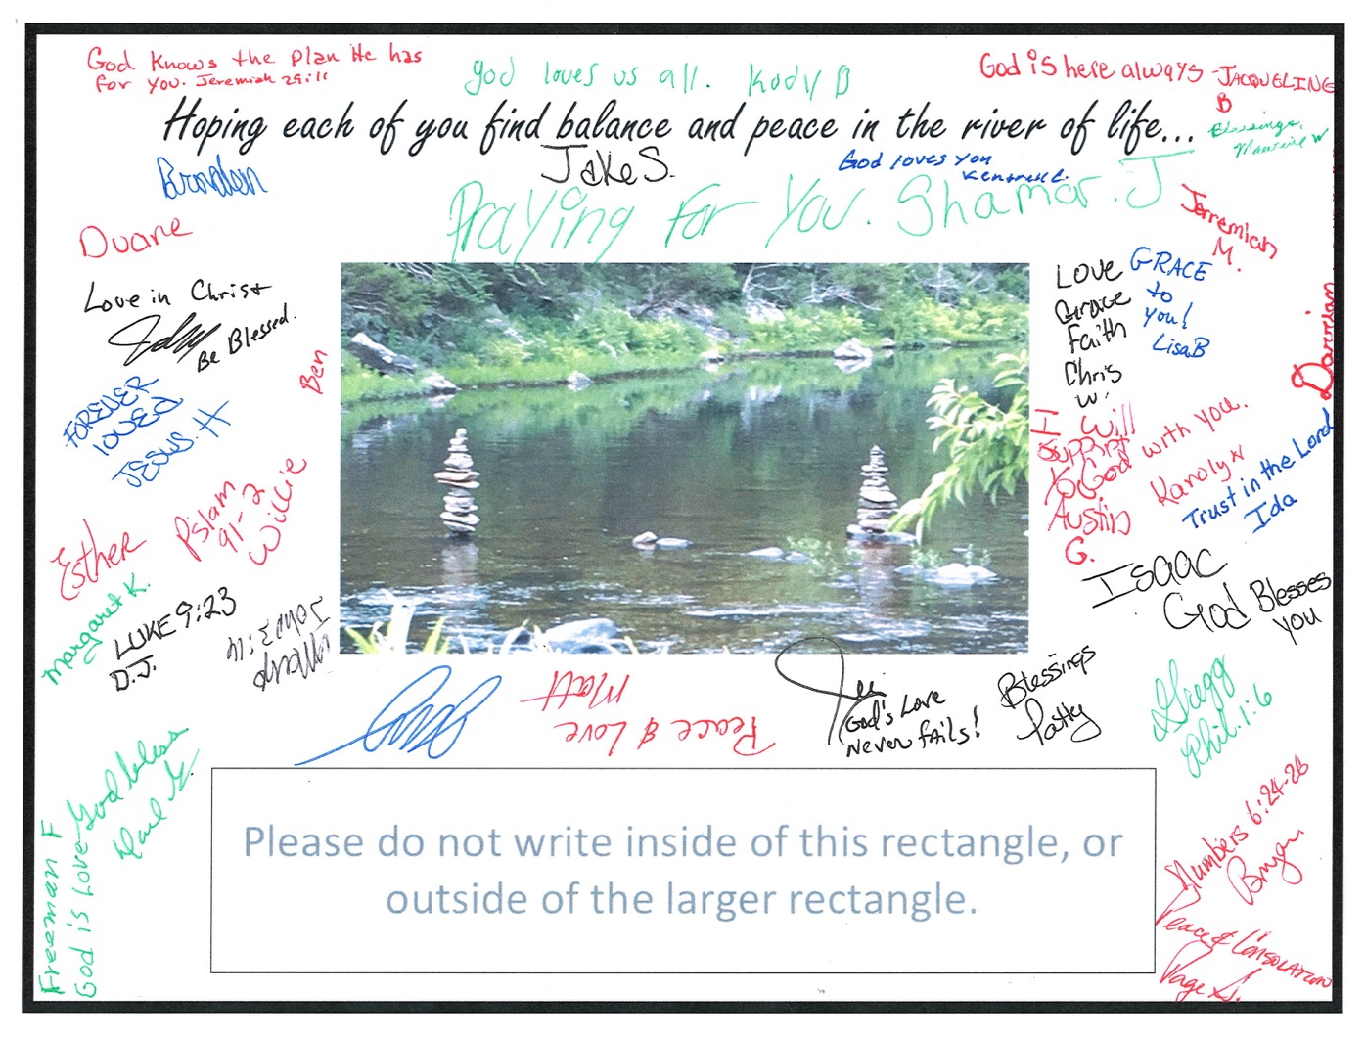
Scan the signed .jpg as a .jpg and import it into the program.

Slide 34
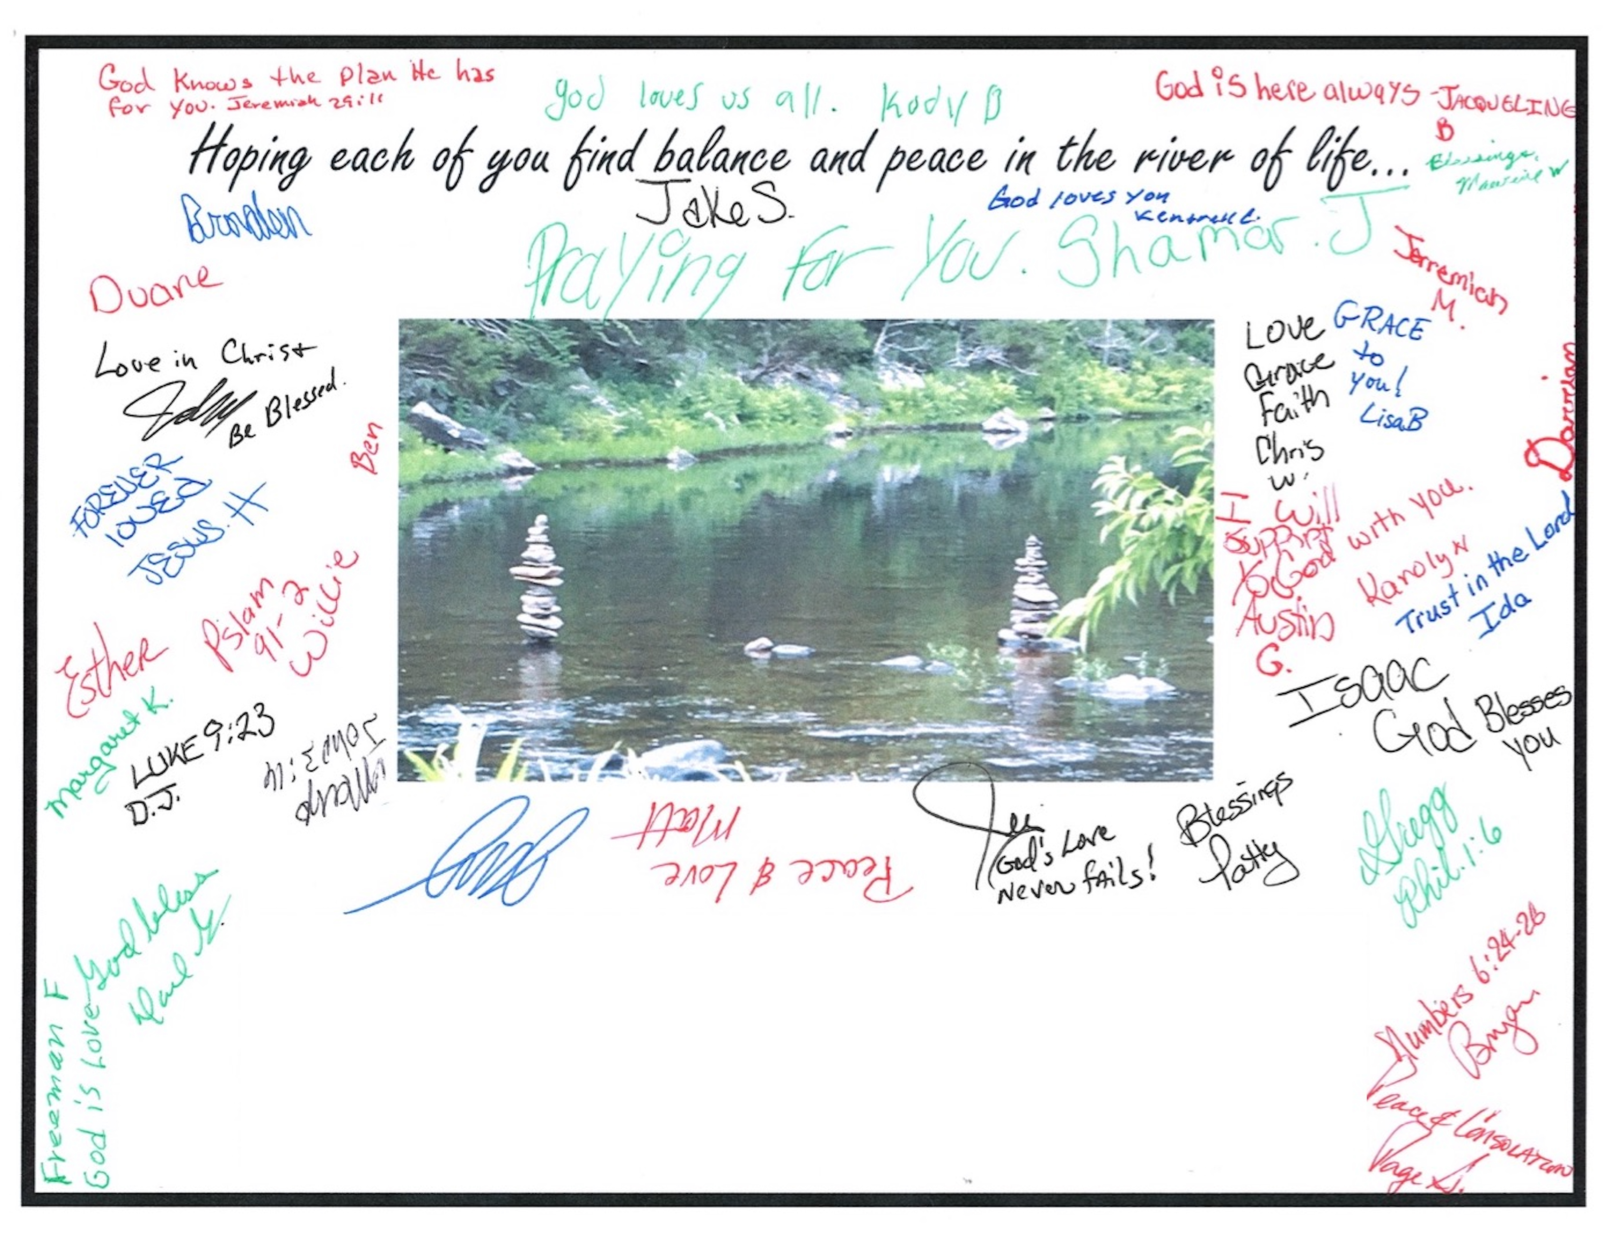
Draw a borderless rectangle of the same fill color as your background (white is always best) and cover the instruction rectangle completely. A red border is used to show the box’s location only.

Slide 35
Your slide will now look like this. Rescan this slide to another .jpg and then import it again to your slide.

Slide 36
Once you have inserted your new .jpg, create a text box over the blank space. A red border has been used and an “x” was inserted only to show the text box location. The “no fill” setting should be used for the text box.
x

Slide 37
Using information from the Kairos Kalendar, create a personal message to the Participants (and perhaps the team), identifying them by location, program and Weekend number.
The font will need to be legible, but small enough to allow the entire message to fit.
The International Kairos Community attending the
2019 Kairos Annual Conference in Orlando Florida, USA
welcomes the new graduates of the
Florida Union Correctional Institution Kairos Inside #88
to the International Kairos Community.

Slide 38
Type or paste your message into the text box. The text box will increase to accommodate what you enter. The text box has been outlined in red only to show the position for this presentation.
The International Kairos Community attending the
2019 Kairos Annual Conference in Orlando Florida, USA
welcomes the new graduates of the
Florida Union Correctional Institution Kairos Inside #85
to the International Kairos Community.

Slide 39
When everything is as you want it, save the document.
The International Kairos Community attending the
2019 Kairos Annual Conference in Orlando Florida, USA
welcomes the new graduates of the
Florida Union Correctional Institution Kairos Inside #85
to the International Kairos Community.

Slide 40
Your slide will look like this. Export again as a .jpg. Open the .jpg and convert it to a .pdf in either Preview or some other Photo program. Then attach it to an email and send it to the Agape Email address for the Weekend from the Kairos Kalendar.
The International Kairos Community attending the
2019 Kairos Annual Conference in Orlando Florida, USA
welcomes the new graduates of the
Florida Union Correctional Institution Kairos Inside #85
to the International Kairos Community.

Slide 41
When the Agape Leader/Coordinator receives the email, they can print it out and set printer so that the .pdf will fill an entire sheet of paper, either US Letter or A4.
The International Kairos Community attending the
2019 Kairos Annual Conference in Orlando Florida, USA
welcomes the new graduates of the
Florida Union Correctional Institution Kairos Inside #85
to the International Kairos Community.

Slide 42
Once you have successfully scanned and sent the .pdf, your slide is ready to make changes in the text box for another unit. Just follow the same steps, personalizing the message, using the information from the Kairos Kalendar and send it away.
The International Kairos Community attending the
2019 Kairos Annual Conference in Orlando Florida, USA
welcomes the new graduates of the
(Name of institution or community) Kairos (program) #(weekend number)
to the International Kairos Community.

Slide 43
ALL IN – EXCELLENCE
Notes:
All In calls us to excellence.

Slide 44
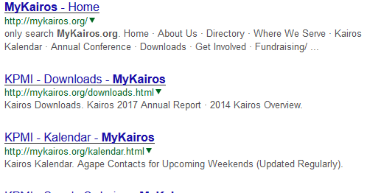
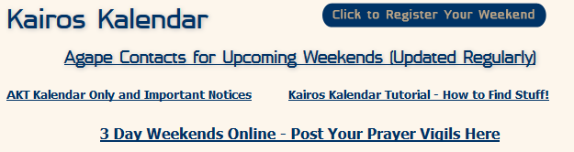
Emailing Agape Directly
Agape you made and emailed has arrived for the Weekend!
Notes:
This is the flow chart of how to email agape directly from your computer to the Weekend Agape Leader/Coordinator. Go to mykairos.org. Click on the Kairos Kalendar. Click on “Agape Contacts for Upcoming Weekends”. This will provide an excel spreadsheet of all of the Weekends registered. With this information, you are able to personalize the greeting to the Weekend you are sending agape to… you already have who you are sending the agape from. Remember most Advisory Councils are committed to 2 Kairos Weekends a year, so you’ll need to update the agape on July 1st (insert a new image or picture and add a different greeting, blessing or prayer) so new, fresh agape arrives for the new Kairos Residents, Participants or Guests. All you have to do is attach the agape to your message to the Weekend Agape Coordinator/Leader.

Slide 45
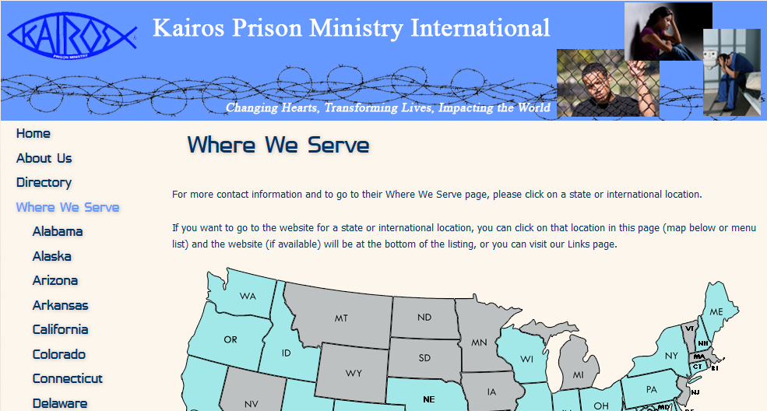
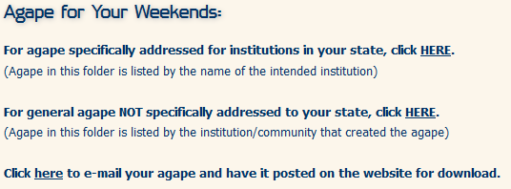
Agape for Weekends “Where We Serve”
Drop In or Gather Up
Click on your state or country
Agape emailed from you or to you has arrived for the Weekend!
Notes:
This is the flow chart of how to drop in or gather up agape from MyKairos.org. Click on “Where We Serve”, click your state or country, click “Agape for Your Weekends”.
Drop in agape to go to places outside of your state – click the bottom line “Click here…..” Bill at Kairos will direct the agape to the designated institution. For agape specifically addressed for institutions in your state, click the top line. The click in the center is for general agape NOT specifically addressed to your state. This is where you find copies of agape that is being sent out to anyone who needs agape – but there is no personalized greeting.
It is important to look for the agape on this website…. It does not come directly to the Weekend Agape Coordinator/Leader’s email account listed on the Kairos Kalendar.
Just follow the directions…and if there is a problem… email bill@kpmi.org and ask for help.

Slide 46

Caution:
Advisory Councils
Must Update Agape on
“Where We Serve”
Agape specifically addressed for Southwest Oklahoma Juvenile Center appeared!
? !
To remove outdated agape on “Where We Serve,” send message to bill@kpmi.org
With the web address of the agape.
http://www.agape.mykairos.org/General/OK%20Great%20Plains%20Emmaus.pdf
Notes:
This is a cautionary note to update agape on mykairos.org “Where We Serve”. I checked out what was available to Southwest Oklahoma Juvenile Center. A word of encouragement from the Great Plains Emmaus Community…with some beautiful, surprising names on the agape. Several of these people had even served on Kairos Torch teams ---- and Bob Wiseman started Kairos Torch 19 years ago!
Maxine’s celebration of life service was December 2011. Bob’s celebration of life service was October 2016. This piece of electronic agape was removed from the mykairos.org on April 22, 2019 by sending a message to bill@kpmi.org

Slide 47

Encouragement –
Advisory Councils
Are Invited to Send More
Just follow the “Click here to email your agape and have it posted on the website for download.”
Send more agape soon!
Notes:
This is simply encouragement to have your Advisory Councils continue to send agape. Though this reminds us to use the “Where We Serve” Agape for Your Weekends, let me remind you that agape signed during this conference will be hand carried to your state by a willing volunteer.

Slide 48
For this reason, ever since I heard about your faith in the Lord Jesus and your love for all God’s people I have not stopped giving thanks for you, remembering you in my prayers. I keep asking that the God of our Lord Jesus Christ, the glorious Father, may give you the Spirit of wisdom and revelation, so that you may know him better. I pray that the eyes of your heart may be enlightened, in order that you may know the hope to which he has called you, the riches of his glorious inheritance in his holy people, and his incomparably great power for us who believe. That power is the same …
Ephesians 1:15-19
Notes:
This scripture is preparing for our workshop closing. For this reason, ever since I heard about your faith in the Lord Jesus and your love for all God’s people (UNCONDITIONAL LOVE), I have not stopped giving thanks for you, remembering you in my prayers. (PRAYER CHAIN) I keep asking that the God of our Lord Jesus Christ, the glorious Father, may give you the Spirit of wisdom and revelation, so that you may know him better (PRAYER VIGIL). I pray that the eyes of your heart may be enlightened (THROUGH ALL THE ACTS OF LOVE), in order that you may know the hope to which he has called you, the riches of his glorious inheritance in his holy people, and his incomparably great power for us who believe. That power is the same…
That same power made such a strong impact on one woman. Let us view “Kairos Inside for Women: Finding God’s Love Behind Prison Walls”
Allow Frieda to tell the story of overflowing agape that brought her all in for Christ, all in for Kairos and all in lavishing agape on others.

Slide 49


Slide 50
THE IMPORTANCE OF AGAPE
God’s unconditional love requires our heart,
passion and hands … All In His Name.
Notes:
Lord, God –
We thank you for every Kairos servant attending this workshop about “The Importance of Agape”. May the words, images and expressions be a conduit of your unconditional love to those we serve and those we serve with. Lord, we thank you so much for giving us the opportunity to be your heart, passion and hands – All In Your Name, Amen
You are invited to sign agape around the room as you exit. Thanks again for coming… and remember to stop by the recruiting booth to see more sample s of agape!

